Slide 1
Here VR
Self-help group for the developping VR knowledge and skills

Slide 2
Summary
Scope of the «Here VR group»
Context
MibTec
Self-help meetings
Online courses
Repository
Next Steps
Actions

Slide 3
Scopes of the Here VR group
Open to everybody
Strong focus on PhD students that are the main target and responsible of these actions (Assegnisti and researchers with other positions are welcome)
Having a true interest (and need) in VR techniques
It is not a mandatory activity
If you decide to join the group, you are expected to be active
The group is not meant to «attend and learn».
The idea is «to share and build knowledge and skills together»
Another key element is that «it is in your hand».
Senior researchers give you the input and facilitate the activities.
The organization and the maintenance of the group is in your hands.
This includes the choice of specific topics, timing and organization of the meetings.

Slide 4
Find out more visiting www.mibtec.it
Thanks to its modern technological infrastructure, consisting of interactive CAVEs systems, simulators, immersive virtual environments and VR headsets, the Center promotes applied research aimed at improving people’s quality of life and encourages the development of usable and innovative technologies.
MiBTec is a network of humanists and technologists, collaborating with private and public entities and scientific associations, both at the national and international level. The Center is also open to external academic and industrial business relations.

Slide 5
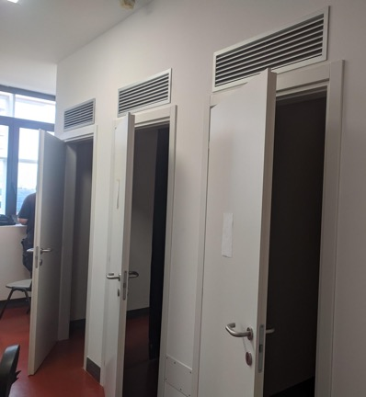
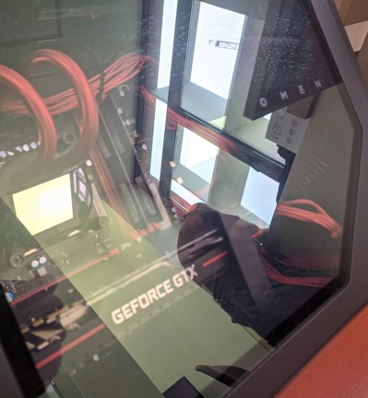
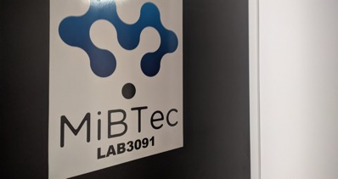
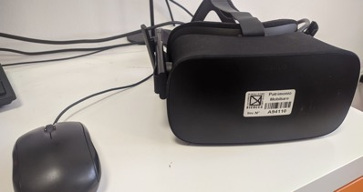
Lab facilities – lab 3091 (U6 - 3° floor)

Slide 6
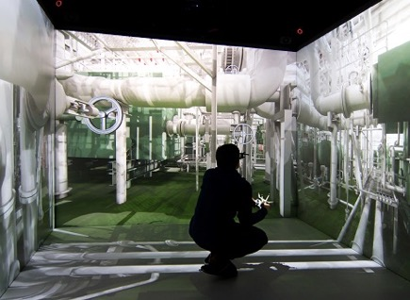
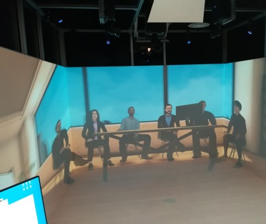
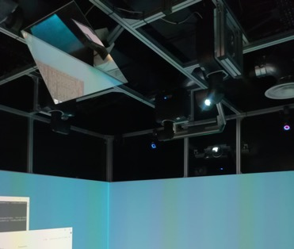
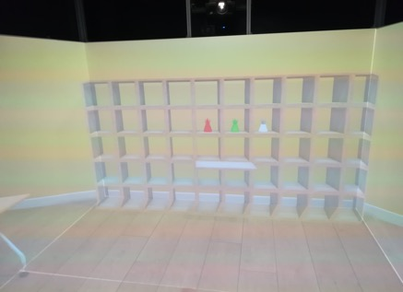
Lab facilities – U9
C.A.V.E. systems

Slide 7
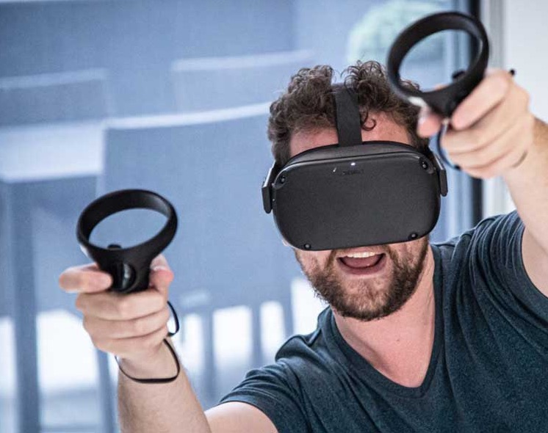
Actions

Slide 8
Self-help meetings
A series of regularly scheduled meetings.
Lab meeting format (one/two topics per meeting)
One person responsible for introducing the topic of the day (Hopefully different every week)
One/two person responsible for the organization and the scheduling of the series (Candidates?)
Examples of potential topics:
Shared problem fixing
Difficulties with a course lesson
Problems with an experiment
Open Discussion
New paper of interest published
Skill development
Specific useful technique learned
A new facility available for the lab

Slide 9
Online courses
Selection of courses available on online platforms (mostly Coursera) that put you in the position of programming the basics of VR autonomously.
Dedicating a few hours per week (let’s say half of a working day per week) in three/four months you will be able to design spaces in Unity, design the navigation and a few interactions with the environment.
By following the same basic courses, you will develop a common language.
(The list will be ready soon and uploaded on the Wiki page dedicated to this group)

Slide 10
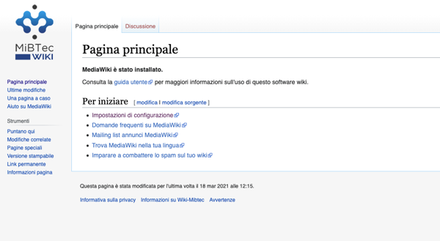
Knowledge repository
https://www.mibtec.it/wiki/
Technical tips
Software and Coding solutions
Hardware and settings
Everything you want to share cooperatively!
https://www.mibtec.it/wiki/

Slide 11
Next steps
Individuate the two PhD students responsible of the Here VR
Enroll the active players: PhD students, technicians, …
Define the first meeting with the active players: this could work again for organize the next point and to introduce oneself to the other people of the group
Schedule the first few meetings (e.g., first five with topics and specific responsible)
Start following the courses

Slide 12
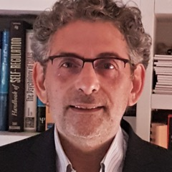
People of reference
PhD school: Prof Marco Perugini
marco.perugini@unimib.it
MibTec Head: Prof Alberto Gallace
alberto.gallace1@unimib.it
Senior Responsible Here VR: Daniele Romano (General Organisation)
daniele.romano@unimib.it
Dr. Alessandro Gabbiadini (Repository and Wiki, LAB 3091)
Alessandro.Gabbiadini@unimib.it

Slide 13
HERE VR Junior responsible

